Slide 1
Use of function generator and oscilloscope

Slide 2
Digital oscilloscope
Components of a DSO
1) analog vertical input amplifiers
2) ADC
3) Writes to memory,
4) a time base which features a triggering and clock drive
circuits for waveform display and reconstruction, the LED or LCD display, and
power supply.
Digital oscilloscopes periodically samples a time varying analog signal ( satisfies Nyquist criterion)
and stores in the waveform memory the signal’s values in correlation with time.

Slide 3
Advantages of a DSO
Since the data is stored, it can be retrieved for viewing and analysis later
Easily do signal averaging to reduce noise
Can get a single shot event ( good for non-repetitive events).

Slide 4
Triggering
How does the oscilloscope know when to start
taking data ?
This is done by setting a trigger. This is usually a voltage level.
Triggering modes AUTO and NORMAL. However, NORMAL is not the normally used mode of triggering.
The normally used mode of triggering is AUTO

Slide 5
Triggering
In auto mode, the scope will trigger whenever a trigger level is met. The trigger can just be a voltage level or a rising or falling edge of a signal or trigger from ch 1 when u r on ch2.

Slide 6
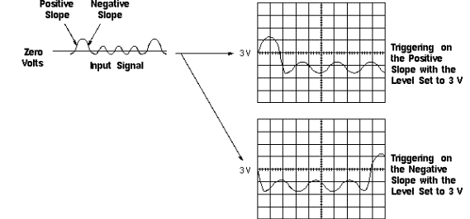
Examples of Positive and Negative Slope Triggering

Slide 7
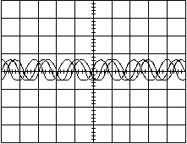
If the trigger condition is not met the oscilloscope will generate its own triggers which is not synchronous with the signal under test.
A simple sine wave can look like this if not triggered properly

Slide 8
Auto mode is useful to see what trigger level to
set when the signal is noisy
Auto mode is also useful to see if there is a dc level offset of the signal

Slide 9
(External trigger ) Normal mode
You can decide which part of the waveform u
can trigger. The trigger can be synchronous with
the signal. It is very useful for single shot operation

Slide 10
Arbitary Function generator (AFG)
Advantages of synthesised waveforms
Almost the only way to have very low harmonic
content in a sine way.
Generate any waveform in software- difficult or
impossible in hardware.
How does the choice of impedance value influence
the waveform?
Set limits on amplitude to protect DUT

